Slide 1
Lung Cancer Risk
Analysis and Modeling
Sameer Mohammad

Slide 2




INTRODUCTION
Health Importance
Cancer is prevalent and severe (ACS, 2023)
Prevention is key
Aim and Purpose
Evaluate factor associations with lung cancer
Factor (Independent) vs Severity (Dependent)
Identify interactions between factors
Factor vs Factor
Create predictive models for lung cancer risk
Hypotheses
Null: No association between any factors and risk
Alternate: There is association between factors and risk
Malhotra et al. 2016
Notes:
Jonathan
Hi everyone, we’re group 10! For our project, we chose to study lung cancer because (according to the American Cancer Society) cancer in general is the second leading cause of death in the US. Lung cancer specifically is one of the deadliest forms, where 5-year survival rates are not promising, even during early stages. As a result, it’s crucial to identify risks early and encourage preventative action in order to stop lung cancer from developing.
Given a set of lung cancer risk factors and lung cancer severity, we first aim to determine correlation strength between each factor and severity to identify the most influential factors of lung cancer risk. Second, we also want to identify any associations between the factors themselves. Finally, based on analysis, we want to create predictive models that can take in new risk factor data and predict lung cancer risk of new patients.
The null hypothesis is that no factors have association with lung cancer severity. However, previous research has shown certain factors like genetics, pollution, and smoking to have strong associations with lung cancer.

Slide 3
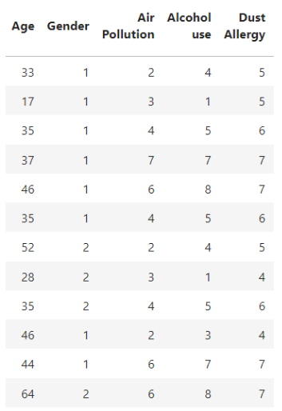
METHODOLOGY
Data Collection
Data.World Lung cancer data (Prithivraj, 2017)
Retrospective data analysis
1000 patients
23 factors (independent), 1 severity level (dependent)
Feature Representation
Evaluate relevance to lung cancer
Behaviors, Conditions, Demographics, Environment, Symptoms
ACS (2023), CC (2023), and May et al. (2023)
Data Cleaning
Identify data errors
Establish consistent measurement scales
Convert categorical risk to continuous numerical risk
Increase model prediction granularity
Notes:
Jonathan
For our project, we chose an existing dataset of 1000 lung cancer patients to conduct retrospective data analysis. Our independent variables include 23 distinct risk factors, and our dependent variable is one measure of lung cancer severity.
To ensure proper feature representation, we evaluated each factor for relevance to lung cancer. For example, eye color wouldn’t have predictive value, so we would omit that factor to reduce signal noise. Based on scientific sources, we confirmed all 23 factors are potentially relevant and formed 5 primary groups: behaviors (smoking), existing health conditions (obesity), demographics (age), environmental factors (pollution), and symptoms (wheezing).
Before further procedures using python and seaborn, we cleaned data for errors such as duplicate patients or missing values. For data scales, we noticed that most factors were scored numerically from 1-9. However, our severity measure was rated categorically (low medium high). So, we converted risk to be numerical for some models so that we could obtain continuous numerical predictions rather than be constrained to only 3 categories.

Slide 4
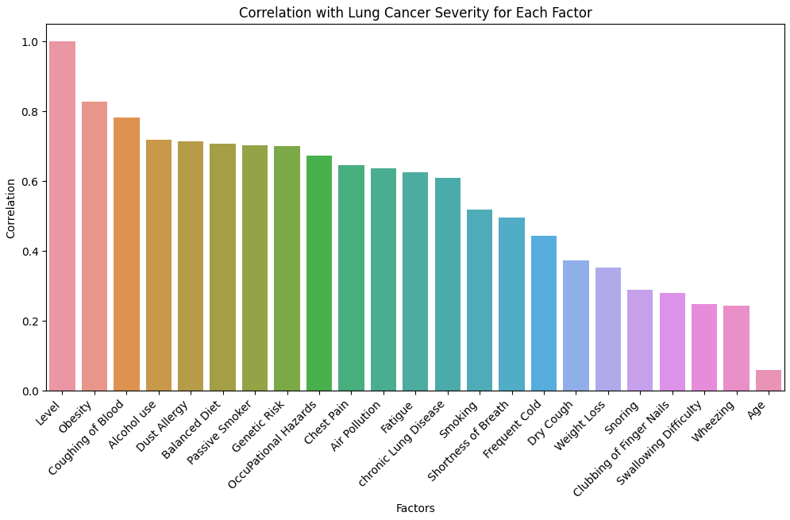
DATA VISUALIZATION
Bar chart (Factor VS Severity)
Strong - behaviors, environment, health conditions, and major symptoms
Weak - Demographics and minor symptoms
Positive correlations expected
Unexpected order of correlation strength (Malhotra et al. 2016)
Notes:
Bhargav
First, we compared each factor with severity and found that most factors have positive correlations with severity. Considering our 5 categories of factors, we found that behaviors (like alcohol use), environmental conditions (like occupational hazards, dust allergy), health conditions (like obesity, chronic lung disease) and major health symptoms (like coughing of blood, chest pain) showed stronger correlations. In contrast, demographics (like age and gender) and mild symptoms (like cough, snoring,weight loss, and wheezing) had weaker correlations.
Comparing to scientific literature, we did expect positive correlations for most factors. However, the order of correlation strength of some of these factors is a bit surprising. For example, we expected smoking, passive smoking,chronic lung disease, and air pollution to show the greatest correlations based on past research. However, within our dataset, we were surprised to find that diet-related factors were most influential (such as obesity, alcohol use, and diet). While coughing of blood and dust allergy were factors we expected to have high correlations, they did indeed show high correlations in our analysis.

Slide 5
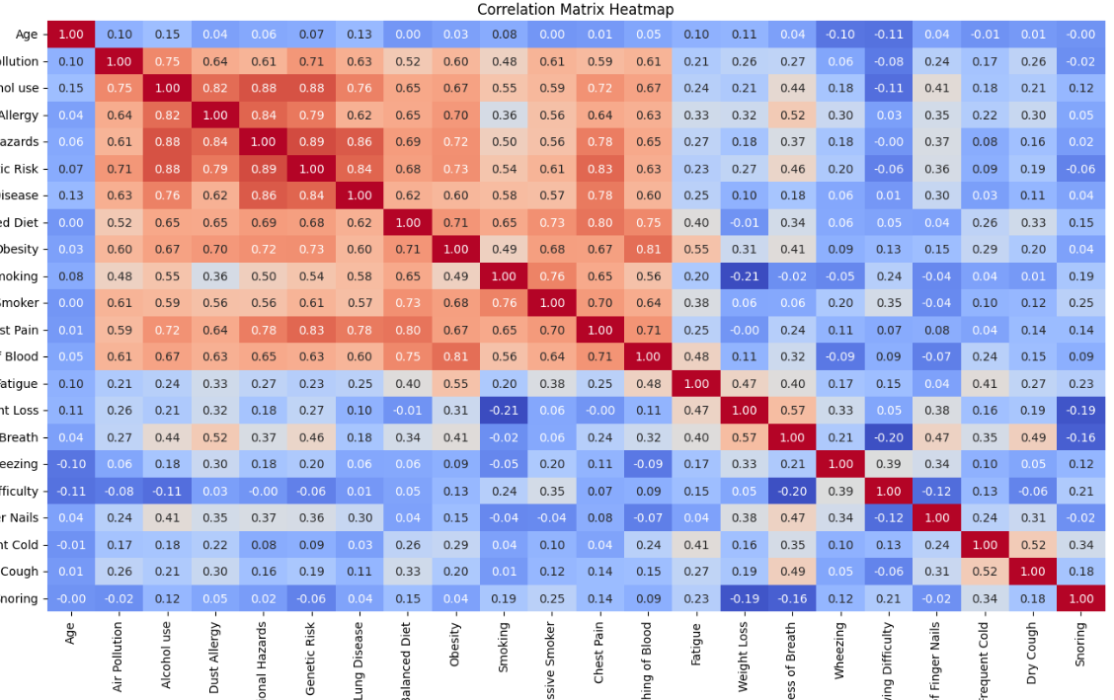

DATA VISUALIZATION
Correlation matrix (Factor VS Factor)
Illustrate correlations in lung cancer-related factors via heatmap.
Chosen for relevance, each contributes to the understanding of lung cancer.
'Coolwarm' color map for visualizing positive/negative correlations; optimized figure size.
Observing patterns provides valuable insights, prompting further analysis.
Crucial for understanding lung cancer; serves as a foundational tool for in-depth analysis.
Notes:
SAMEER
Today, we are excited to share our insights from the visual exploration of key factors related to lung cancer. and conduct a thorough analysis to better understand the major risk factors for lung cancer.
1. Correlation Matrix Heatmap
We began our exploration by selecting relevant factors such as Age, Air Pollution, Alcohol use, Dust Allergy, and more.
Utilizing Python tools, specifically Seaborn and Matplotlib, we calculated a correlation matrix to quantify the relationships between these factors.
Let's delve into the aesthetics and insights from our heatmap.
In the factor vs factor correlation matrix, correlations are color-coded to show weak correlations as blue and strong correlations as red.
Firstly, we found positive correlations between nearly all factors.
Also, we identified an interesting block of factors that hold stronger associations with each other (forming the block of red correlations).
factor vs severity findings, we note that these factors contain major negative behaviors (smoking, alcohol use), environmental concerns (pollution, dust allergy), and severe health conditions (coughing of blood, chest pain).
Factors with weaker correlations are generally mild symptoms (coughing, fatigue).
These are some samples of additional figures, like pie chart and forest plot.
2. Impactful Risk Factors Pie Chart
We further delved into identifying the most impactful risk factors using a pie chart. The chart breaks down the contributions of obesity, pollution, smoking, wheezing, and dry cough. The color choices and design aim to enhance clarity.
3. Forest Plot for Odds Ratios
In visualizing odds ratios, we utilized a forest plot to display variations in odds for different risk factors. This helps identify factors with higher odds of influencing lung cancer. A forest plot is a commonly used visualization technique in meta-analyses, showing the results of the individual risk factor.

Slide 6
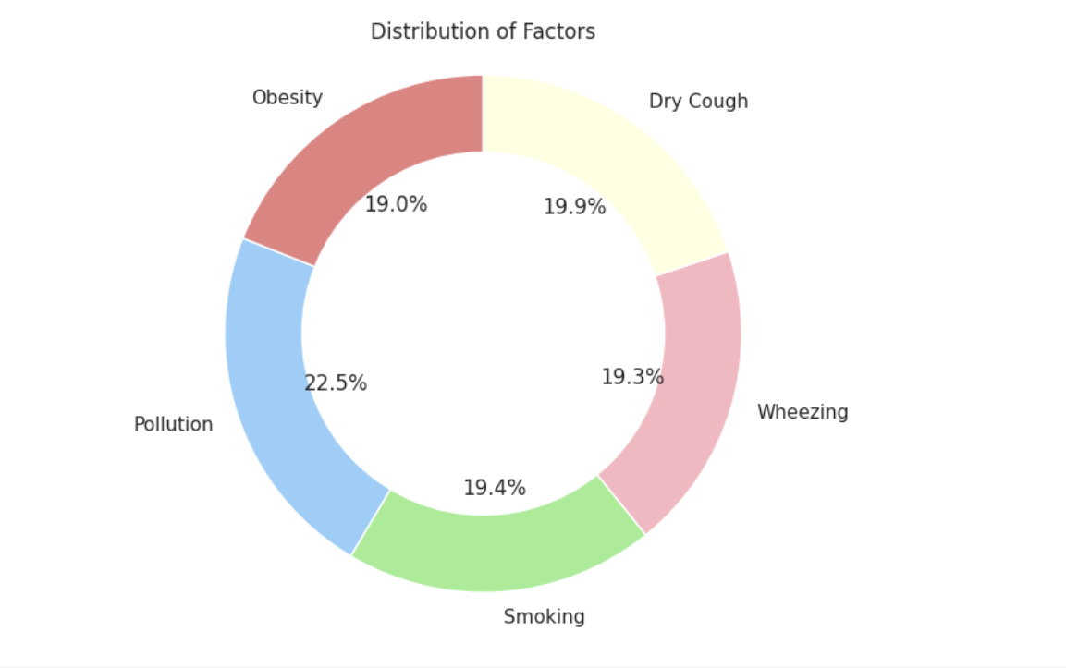
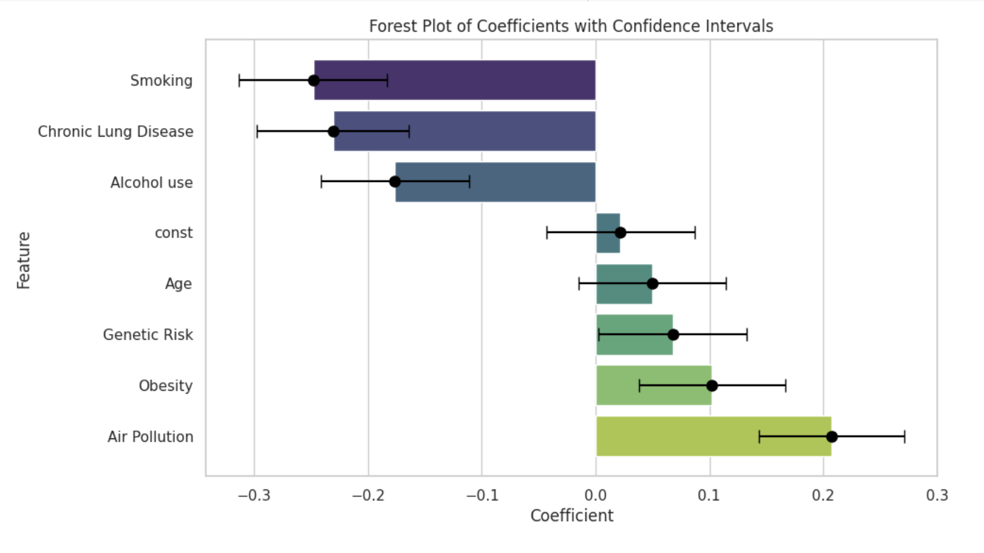
DATA VISUALIZATION
PIE CHART SHOWING DISTRIBUTION OF FACTORS
FOREST PLOT OF COEFFICIENTS WITH CONFIDENCE INTERVALS
Notes:
Sameer
These are some samples of additional figures, like pie chart and forest plot.
2. Impactful Risk Factors Pie Chart
We further delved into identifying the most impactful risk factors using a pie chart. The chart breaks down the contributions of obesity, pollution, smoking, wheezing, and dry cough. The color choices and design aim to enhance clarity.
3. Forest Plot for Odds Ratios
In visualizing odds ratios, we utilized a forest plot to display variations in odds for different risk factors. This helps identify factors with higher odds of influencing lung cancer.

Slide 7
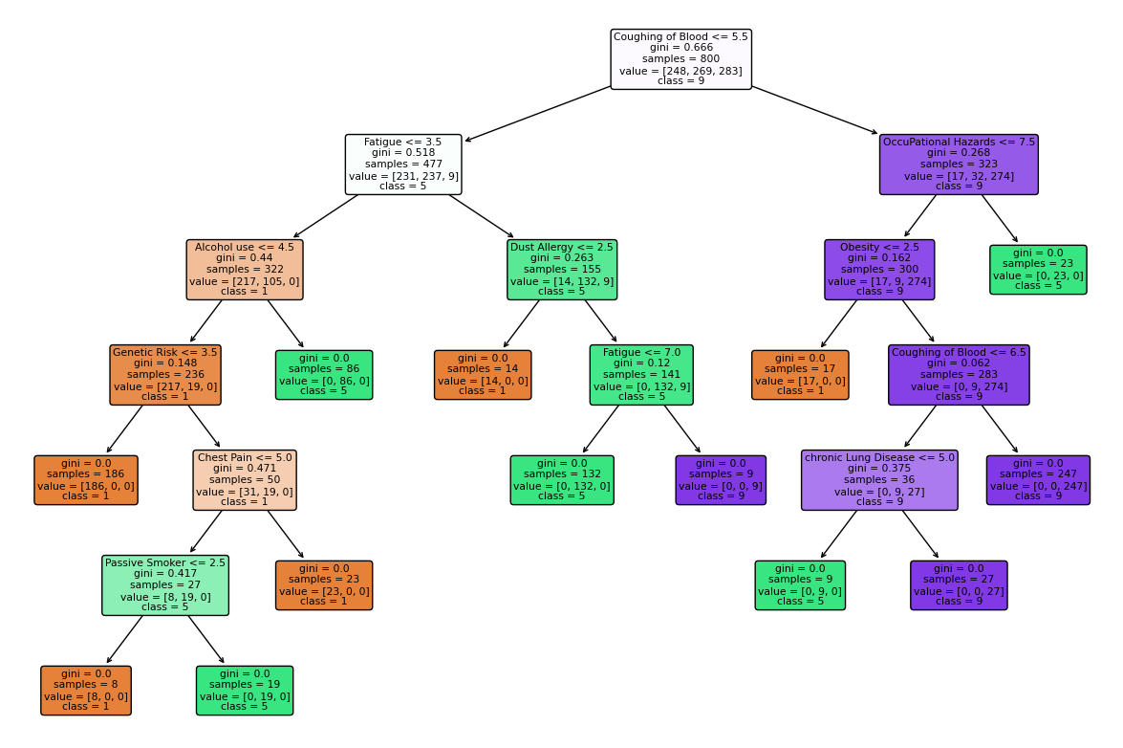
PREDICTIVE MODELING
Model Data
13 factors with strongest associations
Omit weak associations
demographics and general symptoms
Model Types
Categorical
Decision Tree Classification
K-nearest neighbors (k = 7)
Continuous
Linear Regression
Notes:
Pallavi
Based on our analysis of data patterns, we chose to use only the top 13 factors in our models based on correlation with severity. We omitted factors with weaker correlations, because general health symptoms and demographics and didn’t seem to have as much predictive value.
For predictive modeling, we created three distinct models, which include Linear Regression, Decision Tree classification, and k nearest neighbors (kNN). For categorical models, the Decision Tree approach creates a hierarchy of groups based on patient factor data and predicts the severity level of new patients based on this hierarchy. Also categorical, the K-Nearest Neighbors model (with K=7) predicts severity based on comparison to the 7 most similar patients from our dataset. For continuous modeling, Linear Regression estimates severity level by assuming linear relationships between factors and severity and providing a numerical prediction. Each model provides predictions based on varying methods.

Slide 8
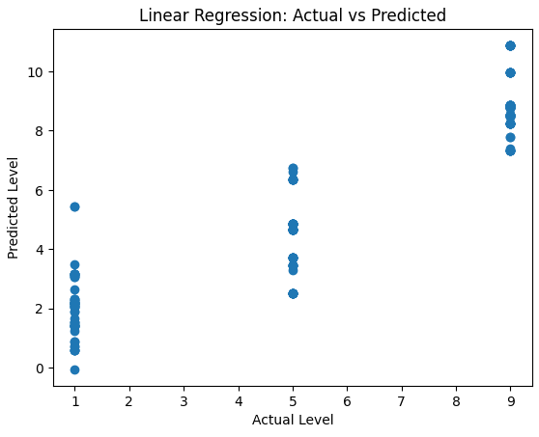


PREDICTIVE MODELING
Model Accuracy Measurements
Accuracy, precision, recall and F1 score
Mean square error and R-Squared
Results
Both categorical models were much more accurate (0.97) than continuous model (0.59)
Discussion
Easier to predict category (low medium high) than continuous value (1-9)
Concern with overfitting training data
may not predict new data well
Notes:
For our predictive models, we evaluated accuracy using several common methods like accuracy, precision, recall and F1-score. For linear regression, we also captured mean square error and r-squared.
For results, we found that both of our categorical models were extremely accurate, with scores of 0.97. In comparison, our continuous linear regression model was not as optimal, with an accuracy score of 0.59.
Though the categorical models may initially seem better at first glance, we note two major considerations. Firstly, it is easier for categorical models to guess accurately when there are only three options (low medium high). Meanwhile, the continuous model is open to all numerical possibilities from 1-9, so predictions are more prone to error. Secondly, there could element of overfitting with our data, where models that match test data too well may not actually predict new data as well.

Slide 9
CONCLUSION
Hypothesis Results
We reject the null hypothesis that our factors have no association with lung cancer severity
Shapiro-Wilk Normality test
data not normally distributed
Spearman correlation coefficient
Statistically significant Factor VS Severity Correlations
Statistically significant Factor VS Factor Correlations
Future Research
These factors have value for lung cancer preventative care
Pattern discrepancies between dataset and literature merit additional research
Our dataset should not be the sole basis of predictive models
Future research required to confirm factor influence
Predictive value may depend on type of model used
Notes:
Lavanya
To conclude, we reject null hypothesis that there are no associations between any of our 23 factors and lung cancer severity because we did find statistically significant correlations. We verified this by first testing for data normality using Shapiro-Wilk. Data was not normally distributed, so we chose to use the Spearman correlation test to evaluate significance of correlations. This test showed statistically significant correlations between factors and severity as well as between factors themselves.
So, we conclude that our factors have predictive value and have utility in lung cancer risk prediction for preventative care. However, because we found discrepancies between our dataset patterns and existing research, we emphasize that our dataset should not be the sole basis of predictive models. Further research should be done to confirm the true weight of each factor. Also, predictive value can depend on the exact type of model used.

Slide 10
REFERENCES
American Cancer Society. (2023). About lung cancer. https://www.cancer.org/cancer/types/lung-cancer/about.html
Cleveland Clinic. (2023). Nail clubbing. https://my.clevelandclinic.org/health/symptoms/24474-nail-clubbing
Malhotra, J., Malvezzi, M., Negri, E., La Vecchia, C., & Boffetta, P. (2016). Risk factors for lung cancer worldwide. The European respiratory journal, 48(3), 889–902. https://doi.org/10.1183/13993003.00359-2016
May, L., Shows, K., Nana-Sinkam, P., Li, H., & Landry, J. W. (2023). Sex Differences in lung cancer. Cancers, 15(12), 3111. https://doi.org/10.3390/cancers15123111
Prithivraj. (2017). Lung cancer data. https://data.world/cancerdatahp/lung-cancer-data

Slide 11
APPENDIX
post final ipynb file of code here

